Slide 1
SIMON Said! (NOT Simon Says)
Renad Alanazi, Jackson Clary, Rayan Syed, Jilin Zheng
Notes:
All

Slide 2
Goals/Usage/Motivation
Goals: Hardware encryption!
Using a host computer, an user can utilize UART and send serial data (consisting of plaintext/ciphertext) to be encrypted/decrypted by the FPGA
SIMON block cipher (National Security Agency)
After the algorithm has been completed, the FPGA will send the appropriate data back (via UART) to the host computer
Usage/Motivation: pervasive computing and IoT
“a hacker should not be able to take control of your insulin pump or override the brakes in your car”
Flexible, optimal, platform independent encryption/decryption
FPGAs, ASICs, microcontrollers, etc.
Low area costs
Notes:
Jilin

Slide 3
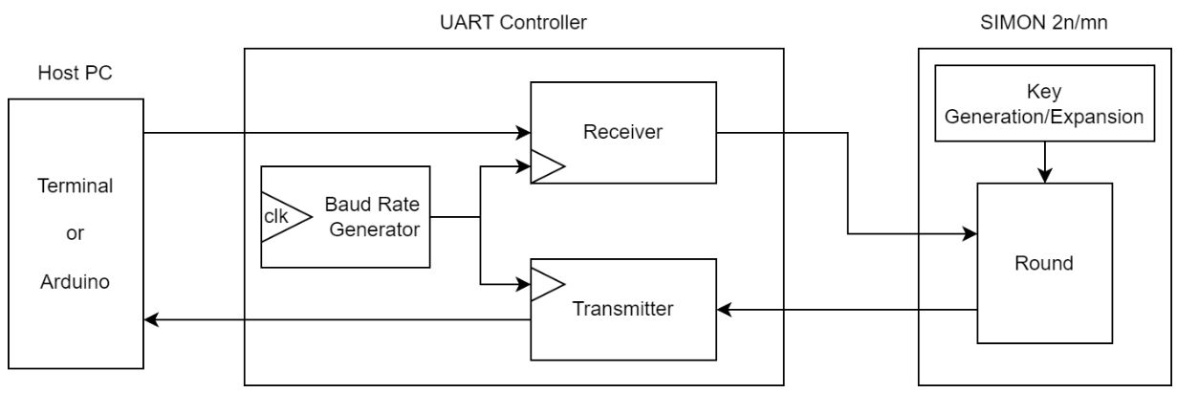
Detailed Block Diagrams

Slide 4
Block Cipher
Notes:
Jilin

Slide 5
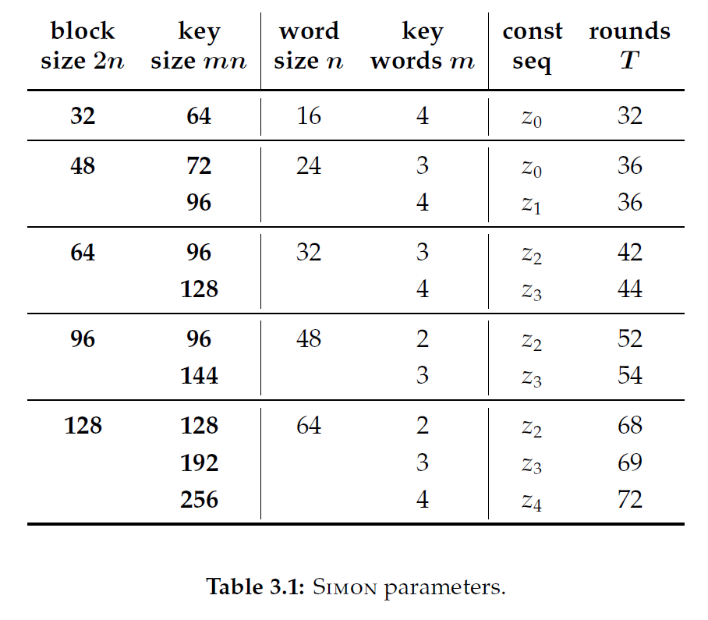
SIMON
Feistel cipher structure
Key expansion
Initialization
Rounds
Round function
Swap
Final permutation
Decrypt using inverse operations
Notes:
Jilin
Key Expansion: A key is expanded into subkeys for each round.
Initialization: The input block is divided into two halves.
Rounds:
For each round:
One half of the block is processed through a round function.
The output is combined with the other half of the block (e.g., XORed).
The halves are swapped for the next round.
Final Permutation: After all rounds, a final permutation may be applied to the output.
Decryption: The decryption process is similar, using the inverse operations.

Slide 6
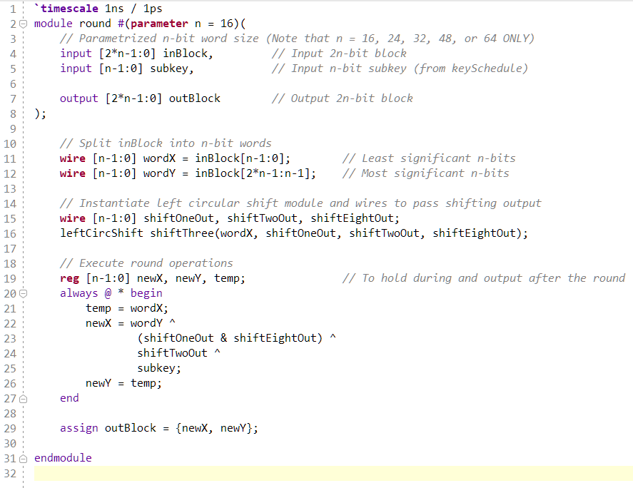
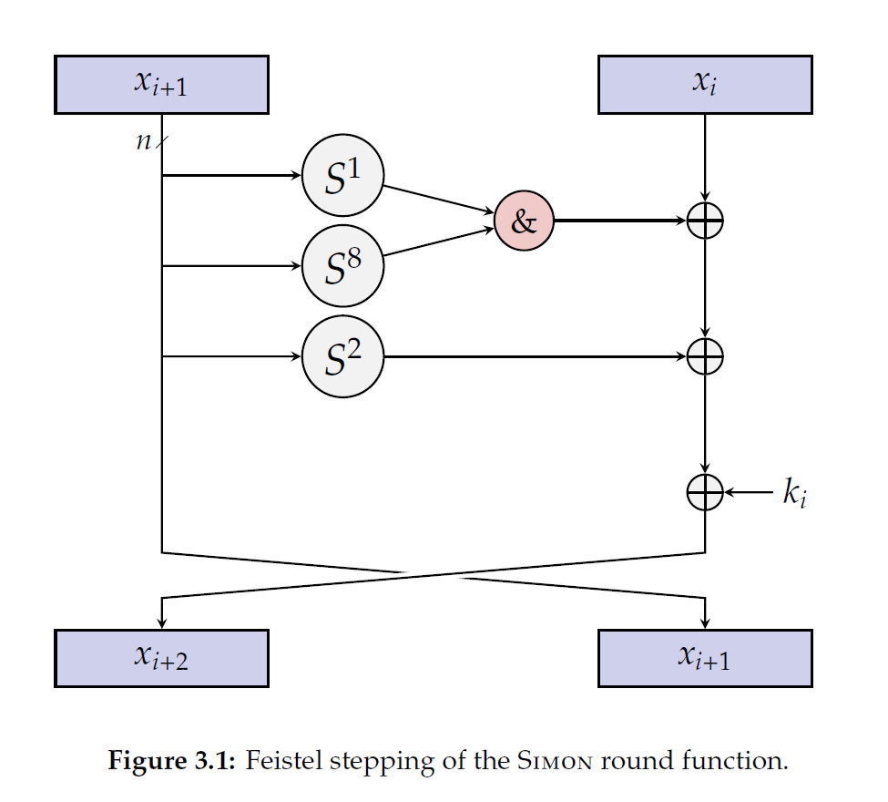
Round Function
Notes:
Jilin

Slide 7
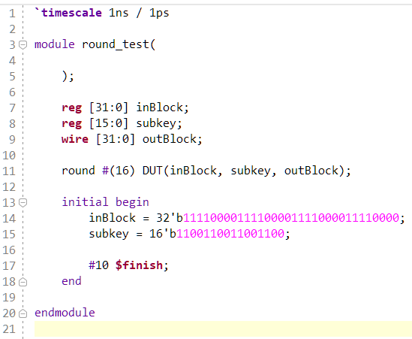
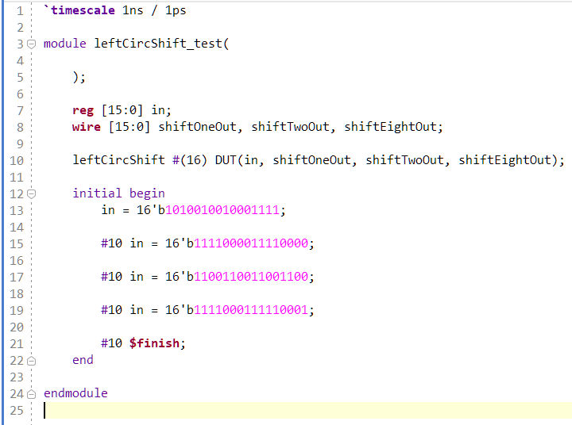
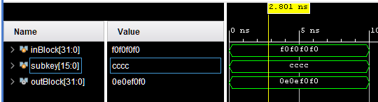
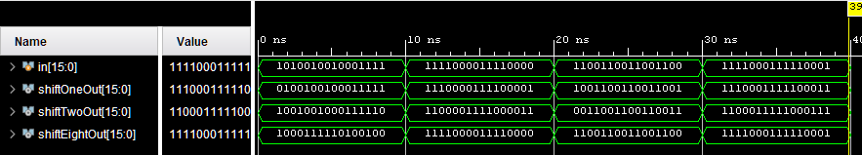

Slide 8
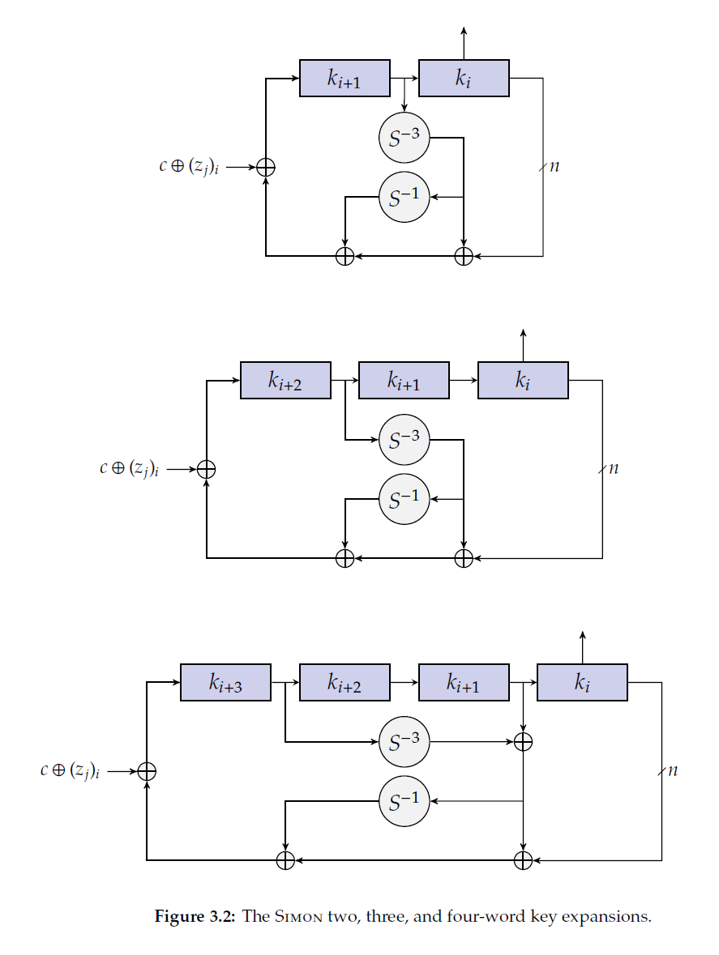
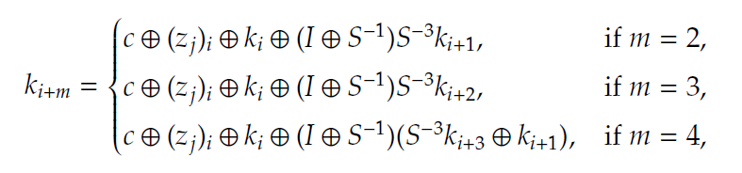
Key Schedule Function
k, [single] round key
m, key words
c = 2^{n} - 4 (n, word size)
(z_{j})_{i}, i^{th} bit of constant sequence z_{j}
Notes:
Jilin

Slide 9
Inputting the Data

Slide 10
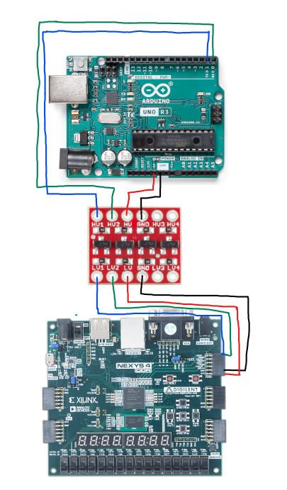
Using Arduino Uno
From the host computer to the Arduino’s serial communication
Unencrypted data from the Arduino to the FPGA
FPGA encrypts the data and send it to the Arduino

Slide 11
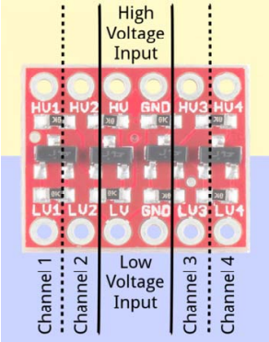
SparkFun Logic Level Converter - Bi-Directional
Basys 3 pmod operate on 3.3V logic
Arduino operate on 5V
Using the logic level converter to step down the 5V to 3V and increase the 3V to 5V

Slide 12
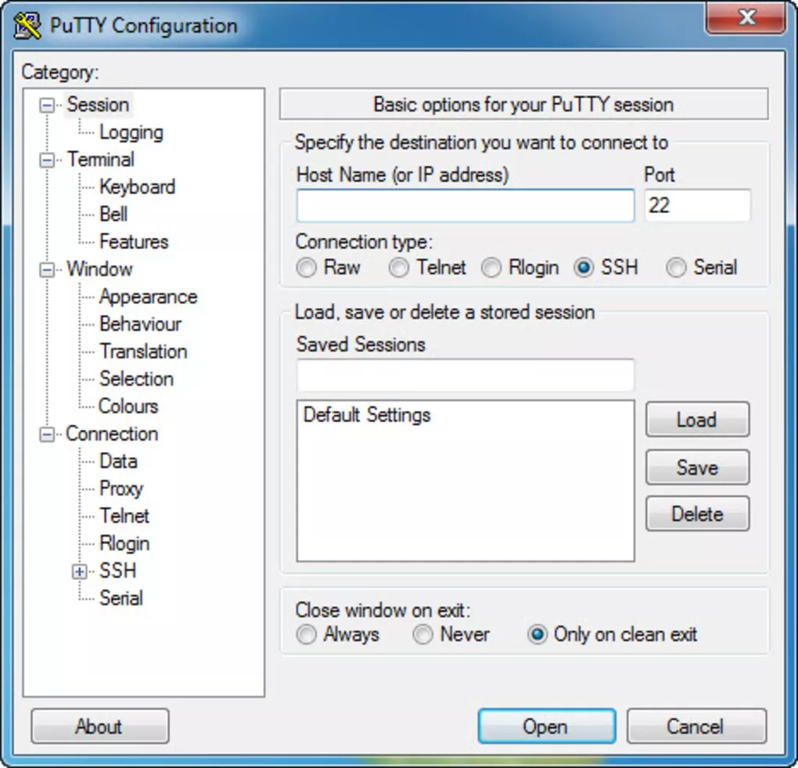
Using PuTTY
A serial console emulator
Converts data between serial and parallel formats.
Potential option to be used to connect lab machine or personal laptop to FPGA board to send data

Slide 13
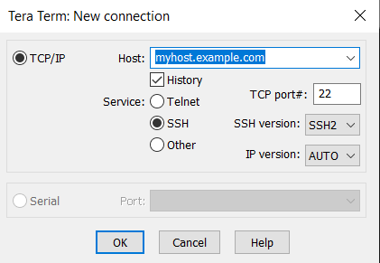
Using Tera Term
Tera Term is a terminal emulator
Can connect to FPGA when physically connected via micro-USB under “Serial”
Option to send binary file to FPGA
Contains data to be encrypted/decrypted

Slide 14
Transmitting the Data

Slide 15
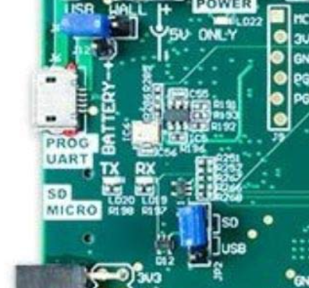
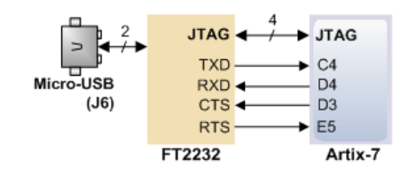
UART
FPGA includes FTDI FT2232HQ USB-UART bridge
Download FTDI USB Serial Port driver from www.ftdichip.com
Has serial ports TXD (for transmitting) and RXD (for receiving)
The terminal file will go through this chip, letting us work with TX and RX
UART module in verilog will constantly take data into FPGA and send it back
The data in will be encoded/unencoded before being turned into data out

Slide 16
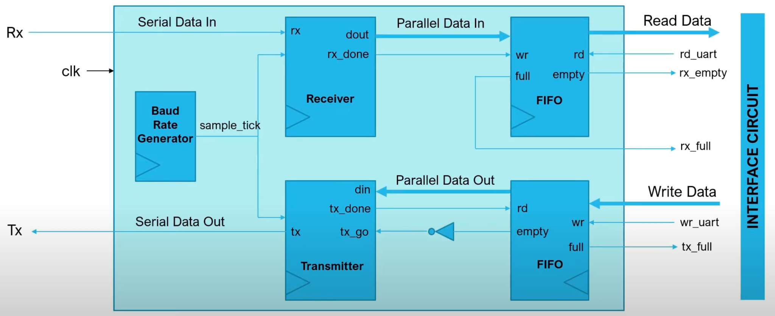
UART Core Diagram (with FIFO)

Slide 17
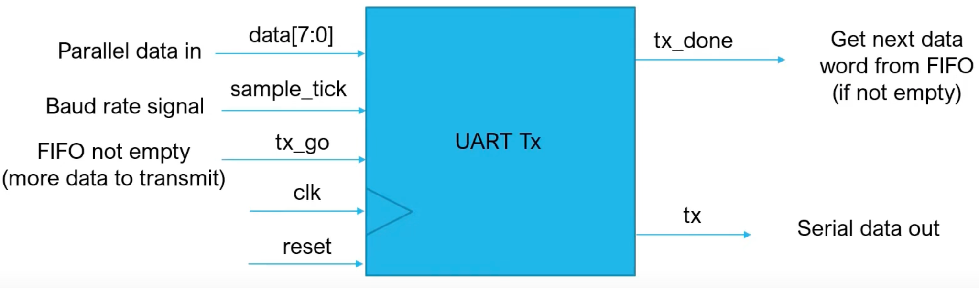
UART Transmitter
A UART transmitter is a component in electronic devices that converts parallel data from a CPU (our PC) into serial form for transmission over a communication line. It’s purpose is to enable reliable, serial communication between devices by formatting and sending data in a sequential manner.

Slide 18
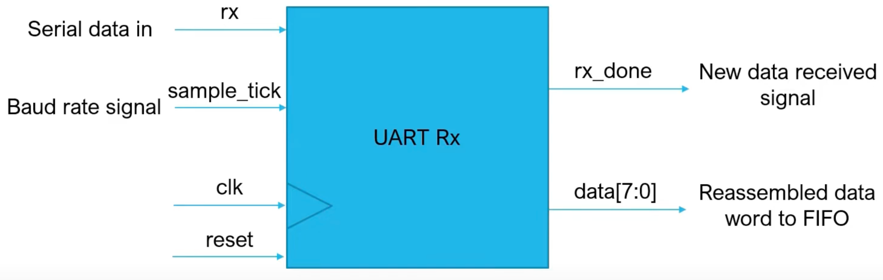
UART Receiver
A UART receiver is a component in electronic devices that receives serial data transmitted over a communication line and converts it back into parallel form for the CPU. Its purpose is to accurately interpret and reconstruct the transmitted data, ensuring smooth and effective communication between devices.

Slide 19
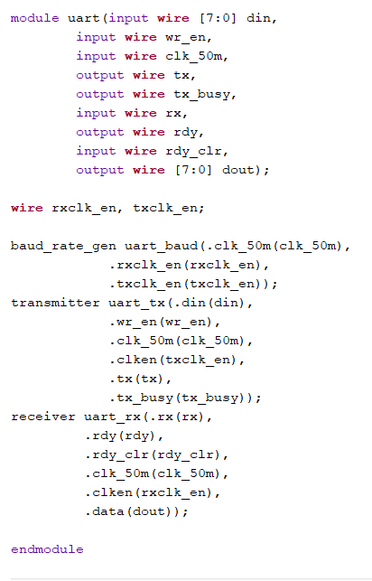
Verilog Module for UART
UART uses baud instead of clock meaning meaning that a module to generate the baud rate (significantly slower than FPGA clock)
Baud rate - max bits per seconds
9600 on Nexys A7 Artix-7

Slide 20
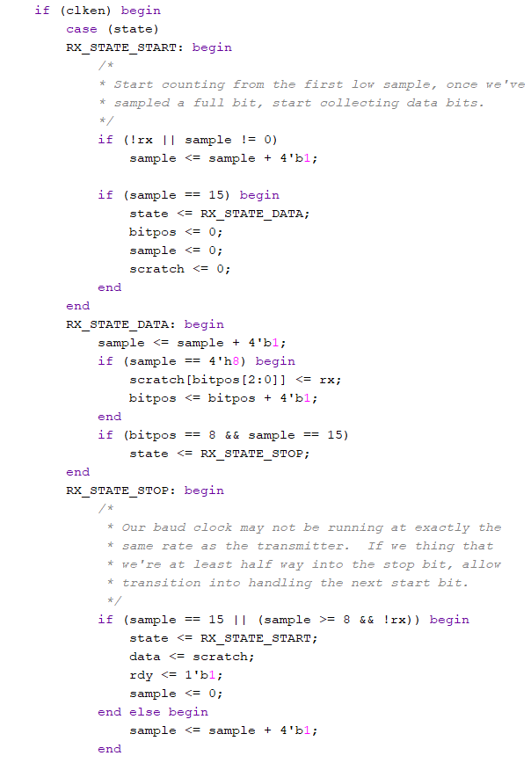
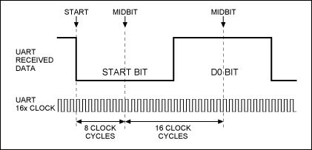
Receiver Verilog Module
Receiver module has input rx and converts it into data using Moore FSM
Start: waits 16 baud cycles before starting sample, state -> data
Data: Samples one bit of data from rx in the middle of a 16 baud cycle count, goes to stop when all data written and 16 baud cycle count is done, state -> stop
Stop: data = 0, baud count = 0, state -> start

Slide 21
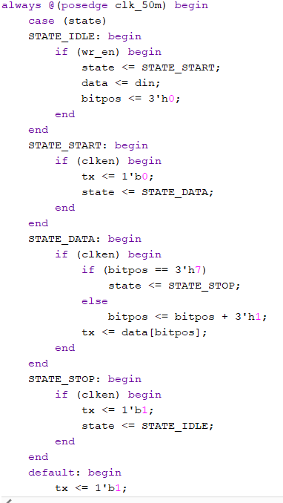
Transmitter Verilog Module
Transmitter module has data input and converts it to output tx using Moore FSM
Idle until ready to start writing, state -> start
Start: tx = 0, state -> data
Data: write data into tx until done -> stop
Stop/default: tx = 1, state -> idle

Slide 22
Successes/Current Progress
Good, working understanding of theory behind each component
Arduino, PuTTy, Tera Term, UART, SIMON
Began implementing SIMON and UART in Verilog
Successful simulation results
NSA resource on verifying encryption
Number of plaintext test cases with the correct ciphertext

Slide 23
Failures/Next Steps
With the lab being brought online, begin testing with physical FPGA boards
Implement key scheduling function for SIMON
Round function cannot be tested without it
Determine if FIFO modules are needed for our project to prevent data loss
Determine procedure to run encryption with Arduino board (i.e. temporarily disconnect)

Slide 24
Thanks!
https://github.com/jilinzheng/SIMON-Said

